Slide 1
External Sorting
具体过程理解
*

Slide 2
External Sorting
Why using merge sort? 快排之类的都是随机访问的，但是Merge是连续访问的，HDD可不支持随机访问(得寻道，找扇区)
To simplify –
☞ Store data on tapes (can only be accessed sequentially)
☞ Can use at least 3 tape drives
*

Slide 3
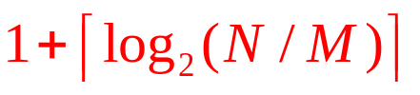
External Sorting
〖Example〗 Suppose that the internal memory can handle M = 3一次只能处理3个数据。N是原始总长度T1。 K个input buffer，还需要2个output buffer
T₁
81
94
11
96
12
35
17
99
28
58
41
75
15
Internal memory
11
12
81
35
94
96
Run
T₂
11
81
94
17
28
99
15
Number of passes
= 1（初始构造）+3
T₃
12
35
96
41
58
75
T₁
11
12
35
81
94
96
15
T₄
17
28
41
58
75
99
T₂
11
12
17
28
35
41
58
75
81
94
96
99
T₃
15
*
Notes:
*
交替使用两个T组

Slide 4
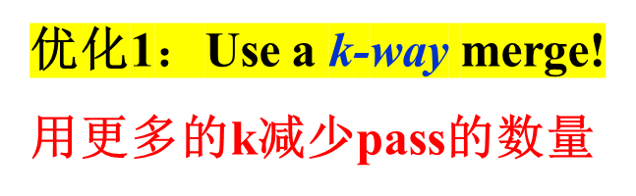

External Sorting
T₁
81
94
11
96
12
35
17
99
28
58
41
75
15
T₂
11
81
94
41
58
75
11
12
17
28
35
81
94
96
T₃
99
12
35
96
15
T₄
12
17
81
81
81
99
99
99
17
81
35
35
99
96
17
28
99
96
 Require 2k tapes!
T₁
11
12
17
28
35
81
94
96
99
T₅
15
41
58
75
Number of passes =
T₆
*
Notes:
*
K和B互为倒数

Slide 5

External Sorting
用k+1条磁带。不是均匀分了，pass多了但是copy次数少了
T₁
34 runs
T₂
17 runs
1 + 6 passes + 5 copies
T₃
17 runs
T₁
17 runs
☹
9 runs
T₂
8 runs
 A smarter way – split unevenly
T₁
34 runs
13 runs
3 runs
1 run
1 run
5 runs
T₂
21 runs
5 runs
1 run
8 runs
2 runs
1 + 7 passes
T₃
13 runs
8 runs
2 runs
1 run
3 runs
*
Notes:
*

Slide 6

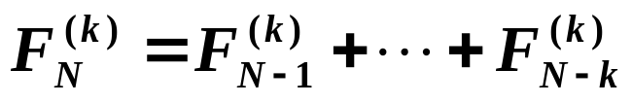
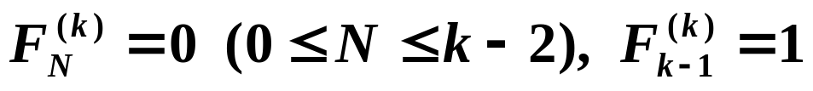
External Sorting
如何不均匀的分？
What will happen if 22 runs are placed on T₂, with
12 on T₃ ?
Claim: If the number of runs is a Fibonacci number F_{N}, then the best way to distribute them is to split them into F_{N–1} and F_{N–2} .
Claim: For a k-way merge,
where
使得最后一项为1
*
Notes:
*

Slide 7
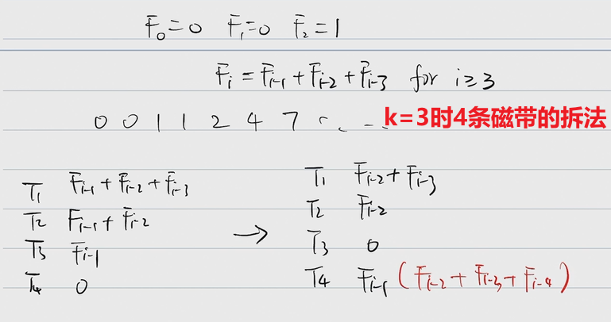

Slide 8
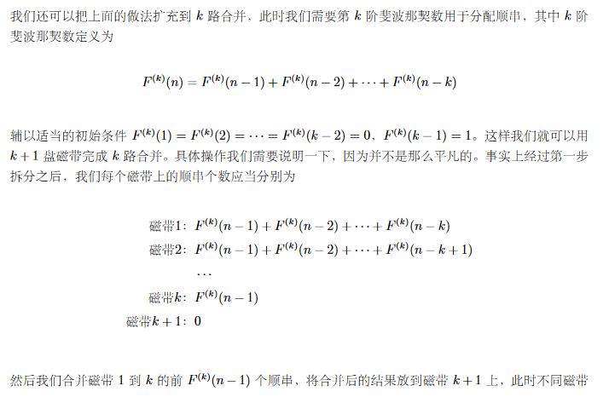
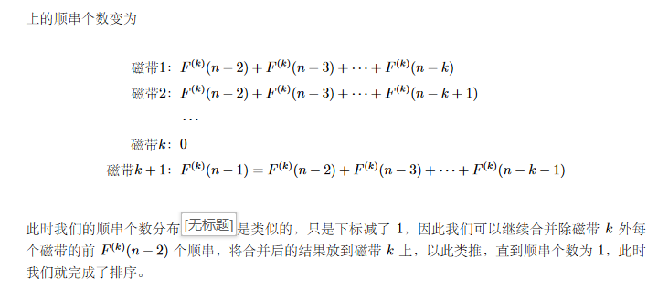
Notes:
滚动，一直往右移动。 最大和最小是相邻的斐波那契

Slide 9
External Sorting
〖Example〗 Sort a file containing 3250 records, using a computer with an internal memory capable of sorting at most 750 records. The input file has a block length of 250 records.
T₁
Internal memory
input buffers
output buffer
☹
T₂
T₁
T₃
Runs
*
Notes:
*
这两页ppt就是说k更大之后由于k比较，需要更大的IO，所以k变大不会线性是的时间减小

Slide 10
External Sorting
2-way merge
input buffers
output buffer
In general, for a k-way merge we need 2k input buffers and 2 output buffers for parallel operations.
k
# of input buffers
buffer size
seek time
block size on disk
Beyond a certain k value, the I\O time would actually increase despite the decrease in the number of passes being made. The optimal value for k clearly depends on disk parameters and the amount of internal memory available for buffers.
*

Slide 11

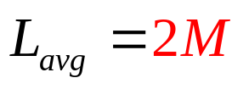

External Sorting
Can we generate a longer run?
81
94
11
96
12
35
17
99
28
58
41
75
15
11
81
94
96
17
12
17
28
35
41
58
75
99
15
94
94
96
35
35
35
35
99
99
99
99
99
81
96
12
12
12
17
99
35
58
58
75
15
15
15
11
81
94
96
12
17
28
35
41
58
75
99
15
*
Notes:
*
这意味着我们使用替换选择算法能使得顺串的数量降低，因此之后合并的趟数也会减
少，从而减少了 I/O 操作的次数。

Slide 12
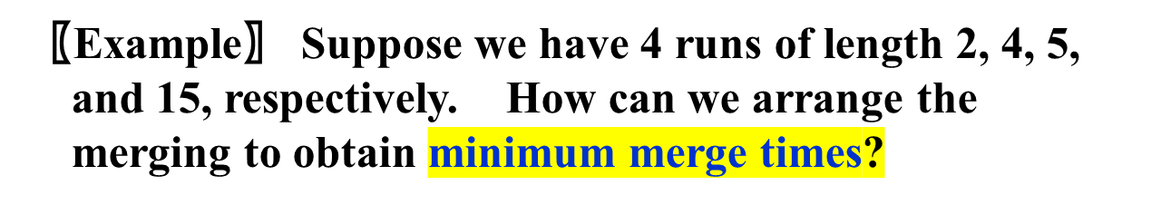
External Sorting
How to minimize the merge time?
26
Huffman Tree!
11
15
6
5
2
4
Total merge time = O ( the weighted external path length )
*

Slide 13
